Slide 1


OBJECT DETECTION USING AI FOR VISUALLY IMPAIRED PEOPLE

Slide 2

OBJECTIVES
DETECTS OBJECTS USING CAMERA
IDENTIFIES THEM USING AI (YOLO)
DESCRIBES SURROUNDINGS USING SPEECH
REAL-TIME, LIGHTWEIGHT, AND PORTABLE

Slide 3
ASSISTIVE VISION USING DEEP LEARNING AND VOICE TECHNOLOGY
ABSTRACT
VISUALLY IMPAIRED INDIVIDUALS FACE SIGNIFICANT CHALLENGES IN NAVIGATING THEIR SURROUNDINGS AND IDENTIFYING EVERYDAY OBJECTS, WHICH CAN IMPACT THEIR INDEPENDENCE AND QUALITY OF LIFE.
THIS PROJECT PRESENTS AN AI-BASED OBJECT DETECTION AND VOICE ASSISTANCE SYSTEM DESIGNED TO SUPPORT VISUALLY IMPAIRED USERS BY PROVIDING REAL-TIME AUDIO FEEDBACK ABOUT OBJECTS IN THEIR ENVIRONMENT.

Slide 4
PROBLEM STATEMENT
VISUALLY IMPAIRED INDIVIDUALS LACK REAL-TIME AWARENESS OF THEIR SURROUNDINGS, MAKING INDEPENDENT NAVIGATION DIFFICULT AND POTENTIALLY UNSAFE. EXISTING ASSISTIVE TOOLS OFFER LIMITED OBJECT RECOGNITION AND SPATIAL FEEDBACK. THERE IS A NEED FOR AN AI-DRIVEN SOLUTION THAT CAN DETECT AND IDENTIFY NEARBY OBJECTS AND CONVEY THIS INFORMATION AUDIBLY TO ENHANCE MOBILITY, SAFETY, AND INDEPENDENCE.
GOAL: EMPOWER INDEPENDENCE WITH REAL-TIME VISUAL AID

Slide 5
SOFTWARE FRAMEWORK AND TOOLS USED
OBJECT DETECTION: YOLOV5 / YOLOV8 (ULTRALYTICS)
DEEP LEARNING: PYTORCH / OPENCV DNN
TEXT-TO-SPEECH: PYTTSX3 / GTTS
CAMERA INPUT: OPENCV
PLATFORM: PYTHON

Slide 6




ARCHITECTURE OVERVIEW
YOLO DETECTION
TEXT-TO-SPEECH ENGINE
IMAGE INPUT
AUDIO OUTPUT

Slide 7
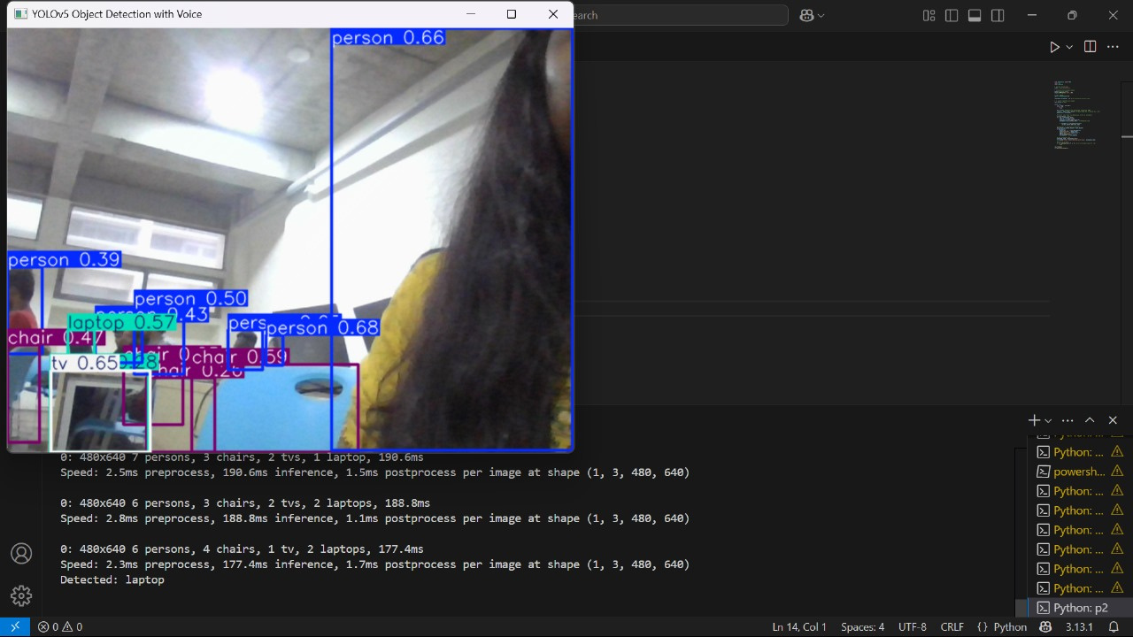
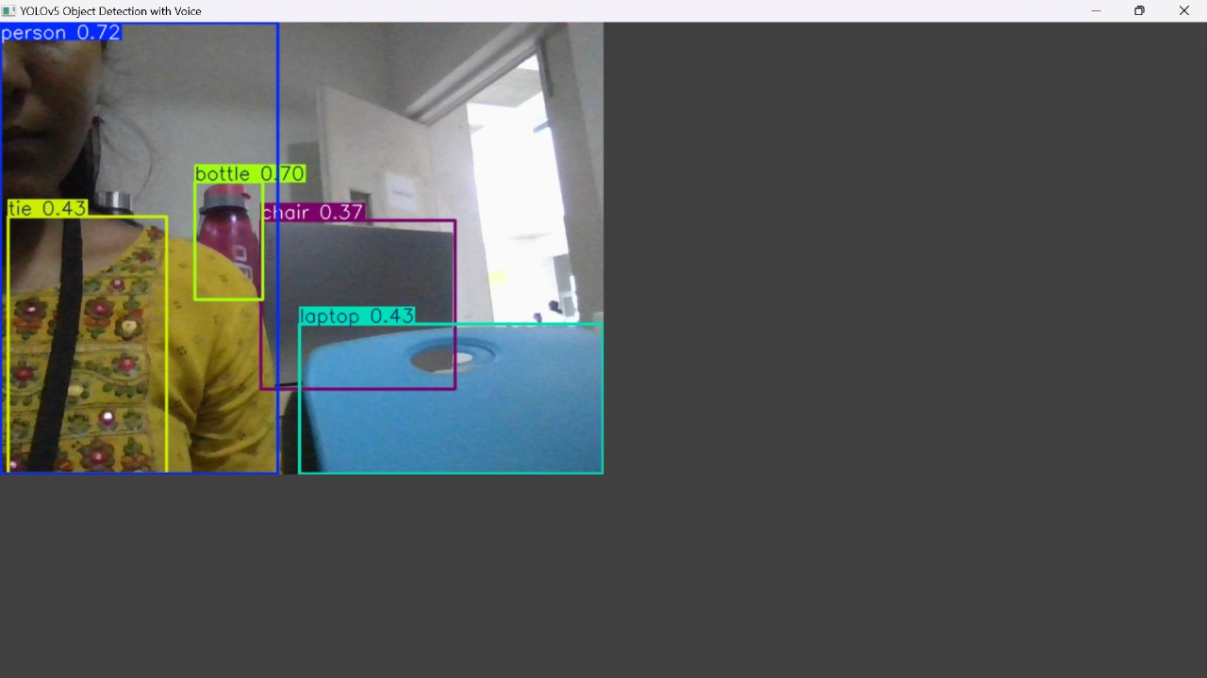
SCREENSHOTS

Slide 8
DRAWBACKS
SOME OBJECTS ARE NOT RECOGNIZED DUE TO LIMITED TRAINING DATA.
SLOW OR SHAKY CAMERA MOVEMENT AFFECTS DETECTION ACCURACY.
CONTINUOUS DETECTION CAUSES REPEATED VOICE OUTPUTS WITHOUT PAUSE.

Slide 9
FUTURE SCOPE
ADD MORE OBJECT CLASSES RELEVANT TO DAILY LIFE.
INCLUDE ULTRASONIC SENSORS FOR DEPTH AND PROXIMITY.
SUPPORT SPEECH OUTPUT IN REGIONAL LANGUAGES.

Slide 10
CONCLUSION
THE SYSTEM PROVIDES REAL-TIME OBJECT DETECTION WITH VOICE FEEDBACK TO ASSIST VISUALLY IMPAIRED USERS. IT ENHANCES MOBILITY AND AWARENESS USING AI AND TTS TECHNOLOGIES. WHILE CURRENT LIMITATIONS EXIST, IT OFFERS A STRONG FOUNDATION FOR FUTURE IMPROVEMENTS IN AFFORDABLE ASSISTIVE SOLUTIONS.

Slide 11
THANK YOU !

